Slide 1
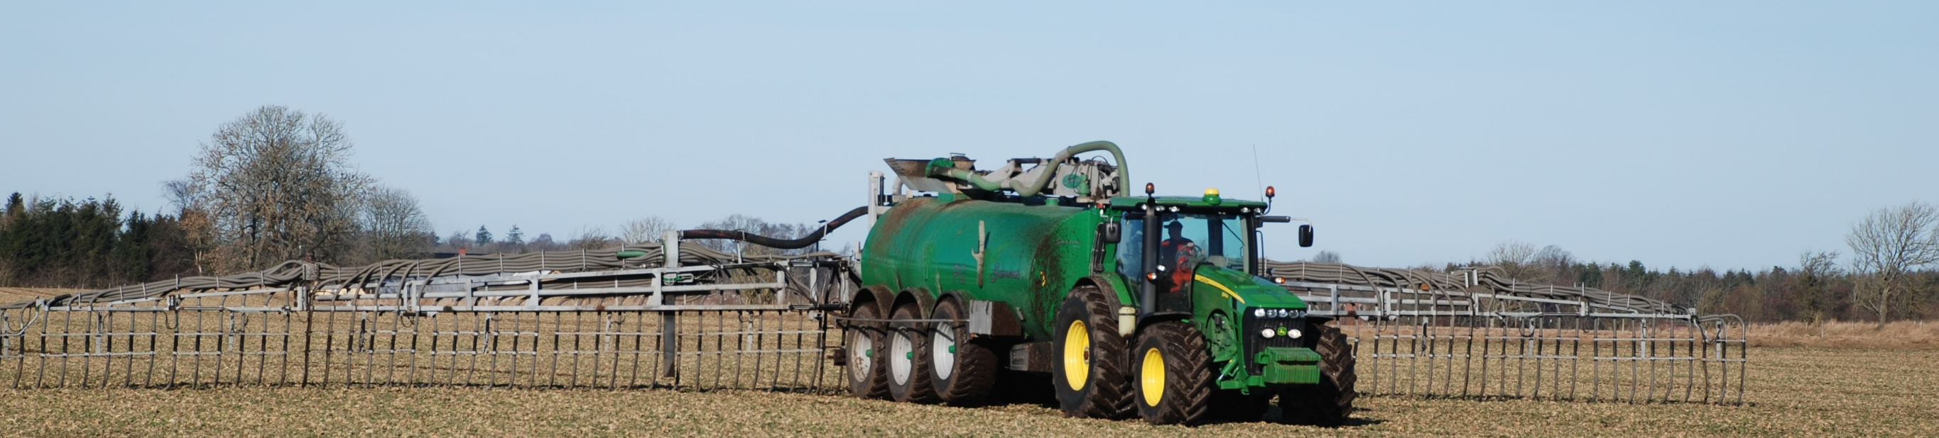
Slurry separation
How manure management affect vertical transport of Cryptosporidium parvum oocysts
P12
Heidi H. Petersen¹, Heidi L. Enemark², Annette Olsen¹, Mostofa Amin³ and Anders Dalsgaard¹
Department of Veterinary Disease Biology, University of Copenhagen, Frederiksberg, Denmark (2) Section for Bacteriology, Pathology and Parasitology, National Veterinary Institute, Frederiksberg Denmark (3) Department of Agroecology, Faculty of Science and Technology, Aarhus University, Tjele, Denmark
B
ackground
R
esults
CONTAMINATION OF DRINKING WATER with pathogens including Cryptosporidium spp. originates primarily from surface water¹.
GROUNDWATER samples are, however, found positive for Cryptosporidium oocysts, e.g. in Germany².
VERTICAL TRANSPORT through soil might be responsible for the presence of oocysts in groundwater.
LIVESTOCK SLURRY contains large volumes of pathogens including Cryptosporidium, and large volumes of slurry are regularly applied to agricultural soil.
MANURE MANAGEMENT PRACTICES could influence the oocyst numbers transported through soil as well as the viability of oocysts.
THEREFORE, we examined the transport of C. parvum oocysts in intact soil columns following either:
Surface application of a liquid fraction of separated pig slurry
Surface application of raw pig slurry
Injection of raw pig slurry
In general, the recovery rate of oocysts in the leachate was low (see below). However, the majority of the 24 leachate samples collected from each soil column, the following were positive for oocysts:
Injected liquid slurry = 21/24 (88%) 0.06% oocysts recovered
Injected raw slurry = 21/24 (88%) 0.02% oocysts recovered
Raw slurry surface applied = 12/24 (50%) 0.01% oocysts recovered
¹
²
²
²
²
S
tudy Design
¹ Sum of total oocysts recovered from all leachate samples collected at all four sampling times (4 L)
² Back-transformed LS-means estimate per L leachate
A total of 3.1 x 10⁶ C. parvum oocysts were mixed with slurry
6 x Liquid slurry
12 x Raw slurry
61 % of leachate samples contained viable oocysts | 39 % of leachate samples had no viable oocysts
Slurry applied on top of soil columns
Slurry injected into soil columns
20 cm
Viable oocysts were found in leachate collected during all four weeks in all three column types
Total numbers of viable oocysts (DAPI+/PI- and DAPI-/PI-) enumerated in all types of leachate samples ranged 76-668 per 4 L
1 L simulated rainfall was applied to the soil columns weekly for 4 weeks
Approx. 1 L leachate was collected following each of the weekly rainfalls
C
onclusions
Oocysts were enumerated and viability was assessed by vital dye staining (DAPI/PI) in the 50 ml leachate following concentration by IMS
Soil columns were sectioned and oocysts enumerated in each section
MANURE MANAGEMENT influences the number of oocysts transported through soil
The SEPARATED LIQUID FRACTION OF SLURRY gave rise to the highest number of leached oocysts leached
INJECTED RAW SLURRY INJECTED induced a higher number of oocysts in the leachate thancompared to SURFACE APPLIED RAW SLURRY.
VIABLE OOCYSTS were revealed during all four weeks in volumes infective for humans
Area where raw or liquid slurry was applied – 17 cm
Area where raw slurry was injected – 10 cm
2 cm
4 cm
20 cm
10 cm
ACKNOLEDGEMENTS: This research was supported by a grant from the PATHOS project funded by the Strategic Research Council of Denmark (ENV 2104-07-0015).
Laboratory technicians Boi-Tien Thi Pham and staff at the Faculty of Agricultural Sciences of
Aarhus University are acknowledged for dedicated technical assistance.
References: ¹ Fricker er al. (1998). Adv. Parasitol. 40, 241-278; ² Gallas-Lindemann et al., (2013) Epidemiol. Infect. 141(1),9-21

